Slide 1
E-BUSINESS
Electronic Business

Slide 2

Introduction to e-Business
E-business or Online business means business transactions that take place online with the help of the internet. The term e-business came into existence in the year 1996. E-business is an abbreviation for electronic business. So the buyer and the seller don’t meet personally.

Slide 3
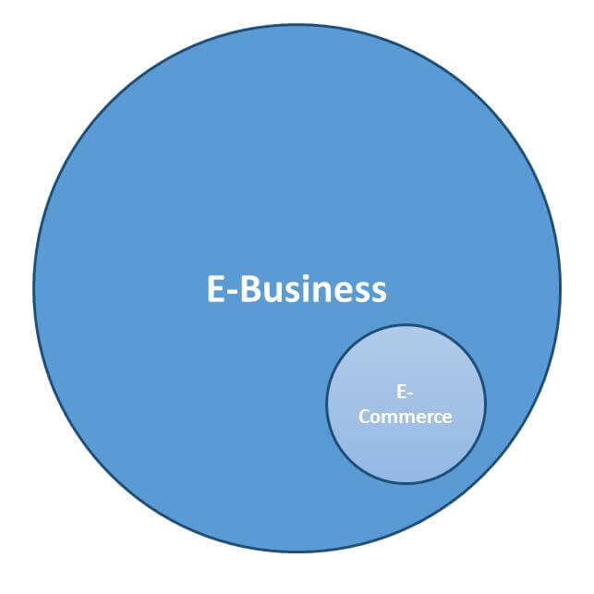
The Difference between E-Business & E-Commerce
Some people use the terms "e-business" and "e-commerce" interchangeably, but they're not synonymous. E-commerce refers to buying and selling online, while e-business encompasses all business conducted online. E-commerce can be viewed as a subset of e-business.

Slide 4



Cont…
Types of e-commerce:
(B2C) business-to-consumer
(B2B) business-to-business
(C2B) consumer-to-business
(C2C) consumer-to-consumer
Types of e-business:
(B2C) business-to-consumer
(B2B) business-to-business
(A2B) administration-to-business
(A2A) administration-to-administration

Slide 5

IBM company
IBM was one of the first companies to use the term e-business when, in October 1997. The company spent approximately $500 million on an advertising and marketing campaign to demonstrate the value of the e-business model and to show that IBM had the "talent, the services and the products to help customers capture the benefits of this new way of doing business," according to the company website. By the year 2000, IBM's e-business revenue had grown to more than $88 billion from $64 billion in 1994, and net income had nearly tripled.

Slide 6

Components Of E-Business

Slide 7
Components Of E-Business
Information
Communication
Transaction

Slide 8




Three key areas are particularly important for e-business:
E-procurement: the electronic sourcing of products and services by companies, focused on reducing costs and effort.
Online stores: the electronic sale of products and services via appropriate platforms, such as online stores.
Online marketplaces: electronic commerce via digital networks, connecting the buyers and suppliers of products and services.

Slide 9
Function of electronic business
Structuring value: an online offer achieves an overview of a large quantity of information.
Selection value: an online offer provides specific database information upon request .
Matching value: an online offer makes it possible to merge inquiries from supplier and buyers more efficiently.
Coordination value: an online offer allows different providers to better combine their services.
Communication value: an online offer improves communication between different consumers.

Slide 10

Pros & Cons Of E-Business

Slide 11


Pros
Freedom
A Feeling of Achievement
You Can Start on a Small Budget
Outsourcing at Your Fingertips
Tap Into a Global Market

Slide 12

Cons
Isolation
You Are 100% Responsible — for Everything
Balancing Work and the Rest of Your Life
No Employee Benefits
Results Don’t Appear Overnight

